Slide 1
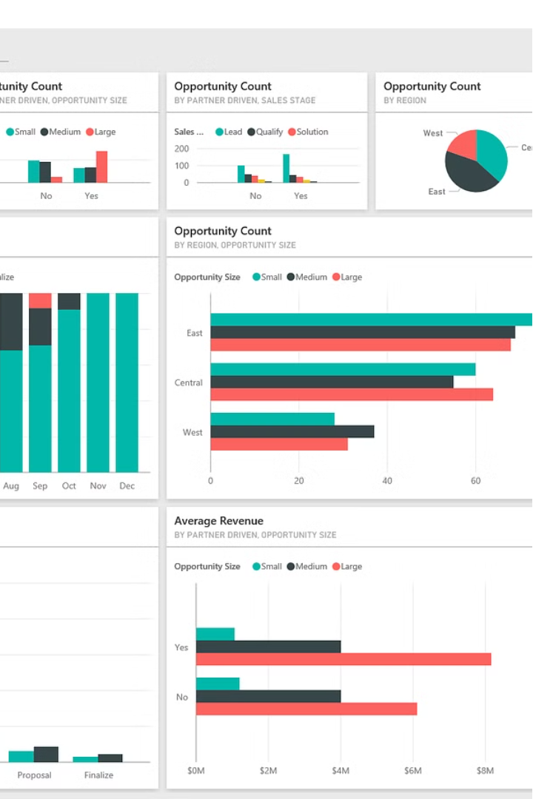

Introduction to Power BI
Power BI is a powerful business intelligence and data visualization tool that allows users to connect to a variety of data sources, transform and model the data, and create interactive dashboards and reports. It empowers organizations to gain valuable insights and make data-driven decisions.
by Rushali Setia

Slide 2
Data Visualization and Dashboarding
Visualizations
Dashboarding
Data Storytelling
Power BI offers a wide range of visuals, from basic charts and graphs to more advanced visualizations like maps, gauges, and treemaps. Users can choose the most appropriate visuals to effectively communicate their data insights.
Power BI's dashboarding capabilities allow users to create interactive, customizable dashboards that provide a unified view of key metrics and KPIs. Dashboards can be shared across the organization for collaborative decision-making.
Power BI's report and presentation features enable users to tell compelling data stories, guiding viewers through insights and facilitating better understanding and action.

Slide 3

Data Modeling and Transformation
1
Data Transformation
Power BI's robust data transformation capabilities allow users to clean, shape, and prepare data from multiple sources, ensuring data quality and consistency.
2
Data Modeling
Power BI's data modeling tools enable users to create complex data models, define relationships between tables, and calculate measures and calculated columns for advanced analytics.
3
Optimized Performance
Power BI's in-memory data engine and optimization features ensure fast query performance, even with large and complex data sets.

Slide 4
Connecting to Data Sources
On-Premises Data
Cloud Data
Power BI seamlessly integrates with a wide range of on-premises data sources, including SQL Server, Oracle, SAP, and more.
Power BI also connects to popular cloud-based data sources like Microsoft Azure, Google Cloud, Amazon Web Services, and a variety of SaaS applications.
Big Data
Real-Time Data
Power BI can handle large-scale data sets, including big data sources like Hadoop, Spark, and Azure Synapse Analytics.
Power BI's real-time data refresh capabilities allow users to monitor and analyze data as it changes, providing up-to-the-minute insights.

Slide 5




Sharing and Collaboration
Sharing
Collaboration
Security
Mobile Access
Power BI allows users to easily share reports and dashboards with colleagues, clients, or stakeholders, ensuring everyone has access to the latest data insights.
Power BI's collaboration features, such as comments and annotations, enable teams to work together on data analysis and decision-making.
Power BI offers robust security and governance features, ensuring sensitive data is protected and access is controlled.
Power BI's mobile app allows users to access reports and dashboards on-the-go, empowering them to make data-driven decisions anywhere.

Slide 6
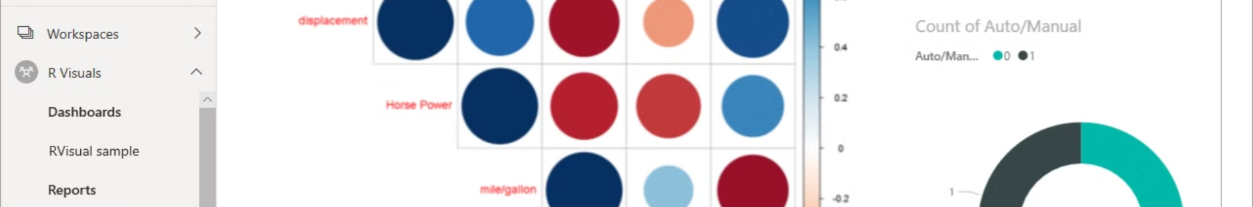



Advanced Analytics and AI
AI Insights
Custom Visuals
R and Python Integration
Power BI's built-in AI capabilities, such as anomaly detection and predictive analytics, help users uncover hidden insights and make more informed decisions.
Power BI allows users to create and share custom visuals, extending the platform's capabilities and enabling the visualization of complex data patterns.
Power BI seamlessly integrates with R and Python, enabling advanced analytical techniques and the use of cutting-edge machine learning models.

Slide 7
The Future of Power BI
Natural Language Queries
Empowering users to ask questions in plain English and receive dynamic visualizations in response.
Augmented Analytics
Leveraging AI and machine learning to automatically generate insights and recommendations based on the data.
Cloud-Native Capabilities
Expanding the integration of Power BI with other Microsoft cloud services, enabling seamless enterprise-wide data management and analytics.
Continuous Innovation
Microsoft's ongoing commitment to enhancing Power BI's features and functionality, ensuring it stays at the forefront of business intelligence and data visualization technology.

Slide 8
THANKYOU

